Slide 1
DLC ASSIGNMENT
Presented By – Mohammad Sohanur Rahman
ID: 23-53829-3

Slide 2
Recently, while traveling by metro in Dhaka, you noticed the automatic crowd management system at the platform entry. For safety reasons, only 10 passengers are allowed on the platform at a time. A yellow boundary line is marked before the platform gates.
• Each passenger’s ticket card has an RFID sensor that detects entry.
• If more than 3 passengers cross the yellow line simultaneously, an alarm should trigger.
The alarm should be activated only when and as long as this condition is met.
• A synchronous counter keeps track of the number of people inside the platform. In a day a
maximum of 20 tickets is issued.
• A 555 timer is used to generate the clock for both counter and alarm.
• The FSM states are encoded as the following: (IDLE → CHECK → OPEN → CLOSE).
• The platform monitoring system sends the current passenger count to the control room in analog form via DAC, while the ADC is used to read sensor inputs.

Slide 3
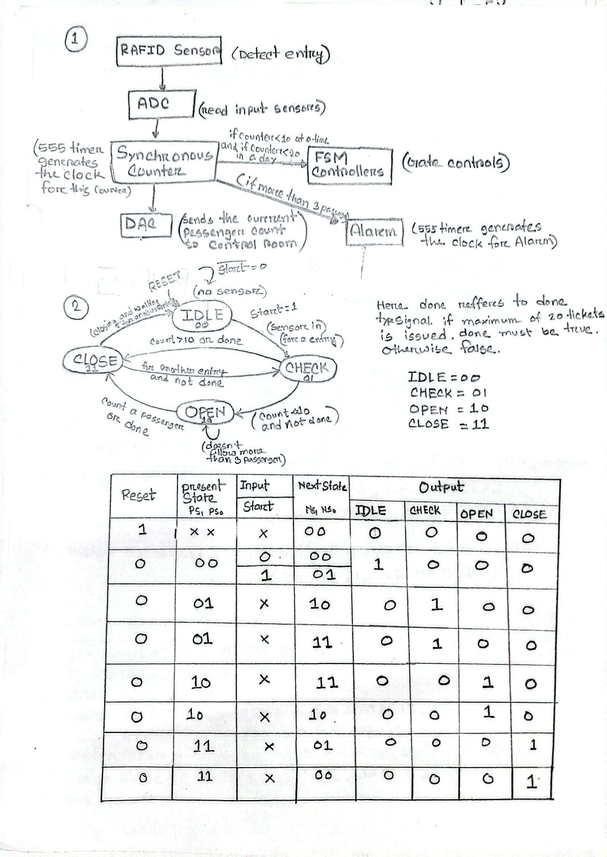
1. Sketch the block diagram of the system showing RFID sensors, ADC, synchronous counter, FSM, DAC, and alarm unit.

Slide 4
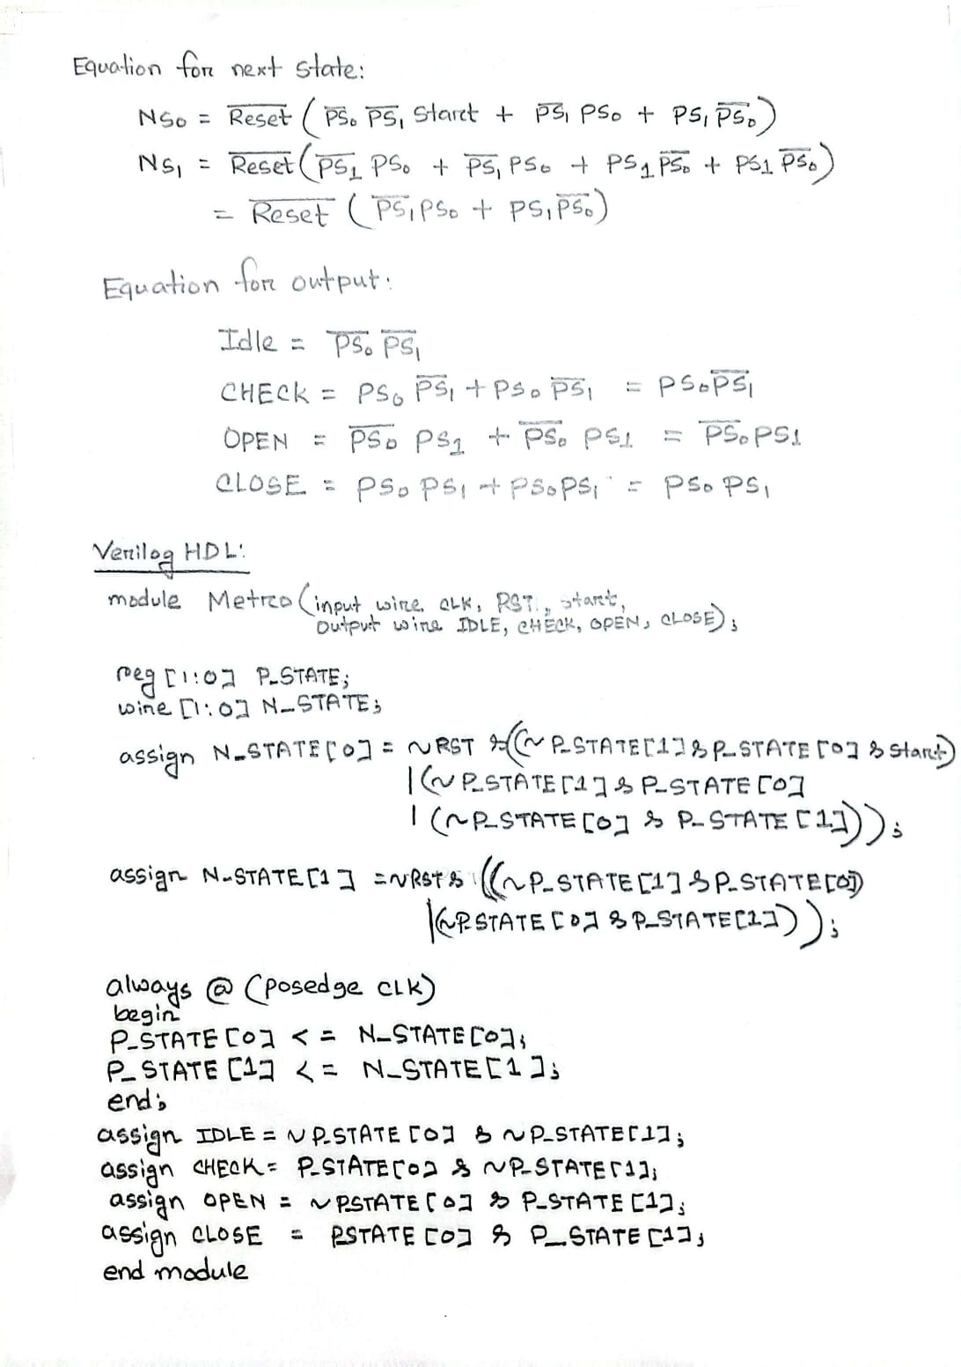
2. Demonstrate how the FSM transitions between IDLE, CHECK, OPEN, and CLOSE states depending on counter values. The FSM transitions from OPEN to CLOSE after 20 tickets are issued.
Also, show Verilog HDL code for the system. [Hint: Use a done-type signal from the counter to transition from OPEN to CLOSE state.]

Slide 5
2. Demonstrate how the FSM transitions between IDLE, CHECK, OPEN, and CLOSE states depending on counter values. The FSM transitions from OPEN to CLOSE after 20 tickets are issued.
Also, show Verilog HDL code for the system. [Hint: Use a done-type signal from the counter to transition from OPEN to CLOSE state.]

Slide 6
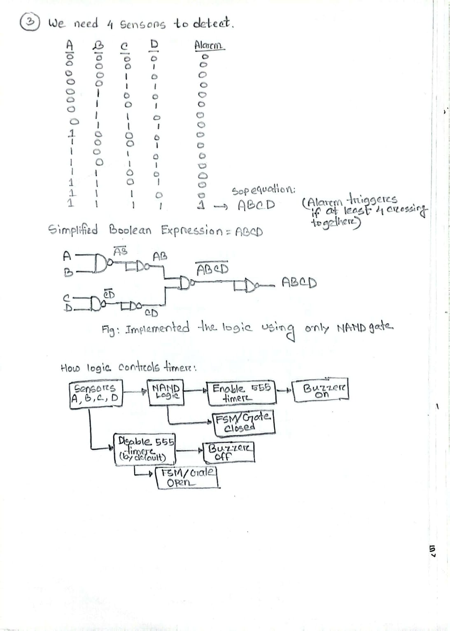
3. The alarm should trigger if more than 3 passengers cross simultaneously. Show the simplified Boolean expression for this condition. Show using only NAND gates. Show how this logic controls timer.

Slide 7
4. Show the 555-timer circuit for the alarm with frequency = P5 Hz and duty cycle = Q% [where P = M+E+T+R+O, Q = 100 – P]. If P5 is not within 250–4500 Hz, set f = 400 Hz.
Select the most suitable capacitor from 50 μF, 250 μF, or 470 μF. [Hint: If P=20, then P5=205.]

